Slide 1
Finding models (SAT solving)

Slide 2
Classical propositional logic
Syntax (grammar)
A statement is
A proposition (any word or symbol you want to make up)
“not” followed by a statement
Two statements connected by “and” or “or”
Use parentheses for disambiguation
Semantics
A truth assignment is gives truth values to propositions
A truth assignment is a model of a statement if the statement is true when you plug in its truth values
It’s a model of a theory, if it’s a model of all the statements

Slide 3
Satisfaction and satisfiability
Most logics have some notion of satisfaction
An object satisfies a sentence
If it doesn’t contradict it
An object satisfies a theory, if it satisfies all its sentences
And is then called a model of the theory
And a theory is satisfiable if something satisfies it
A satisfiability solver is a program that finds models for theories

Slide 4
Truth assignments
The “objects” for our simple logic will be truth assignments
Tables assigning
Truth values
To propositions in the theory being discussed
For example, these are all truth assignments
Proposition | Truth value
A | T
B | F
C | T
Proposition | Truth value
A | F
B | F
C | F
Proposition | Truth value
A | F
B | F
C | T

Slide 5
Truth of sentences in a truth assignment
Truth assignment | (A and B) or C
 | T
 | F
 | T
We can then
Look at the truth of statements
Relative to truth assignments
For the individual propositions
And so we can say
The sentence
(A and B) or C
Is true in
the first and last assignments
But not the middle one
Proposition | Truth value
A | T
B | F
C | T
Proposition | Truth value
A | F
B | F
C | F
Proposition | Truth value
A | F
B | F
C | T

Slide 6
Satisfaction
Truth assignment | (A and B) or C
 | ☺
 | ☹
 | ☺
A truth assignment satisfies a sentence if it makes it true
So the first and last truth assignments are models of the sentence
Proposition | Truth value
A | T
B | F
C | T
Proposition | Truth value
A | F
B | F
C | F
Proposition | Truth value
A | F
B | F
C | T

Slide 7
Satisfiability solving

Slide 8
SAT Solving
So it’s easy to test whether a truth assignment is a model of a given sentence or not
How do we construct a truth assignment for a given sentence?
This is called the Boolean satisfiability problem or SAT
A program that does it is called a SAT solver
Input: sentence in classical propositional logic
Or a theory, but we can always turn the theory into a sentence by joining all its statements with and’s
Output: a model of the sentence, if one exists
How do we find a model?

Slide 9
Brute force
We just said it’s easy to test a truth assignment
So here’s an easy algorithm:
Try every truth assignment
Test it
Here’s the problem with that …

Slide 10
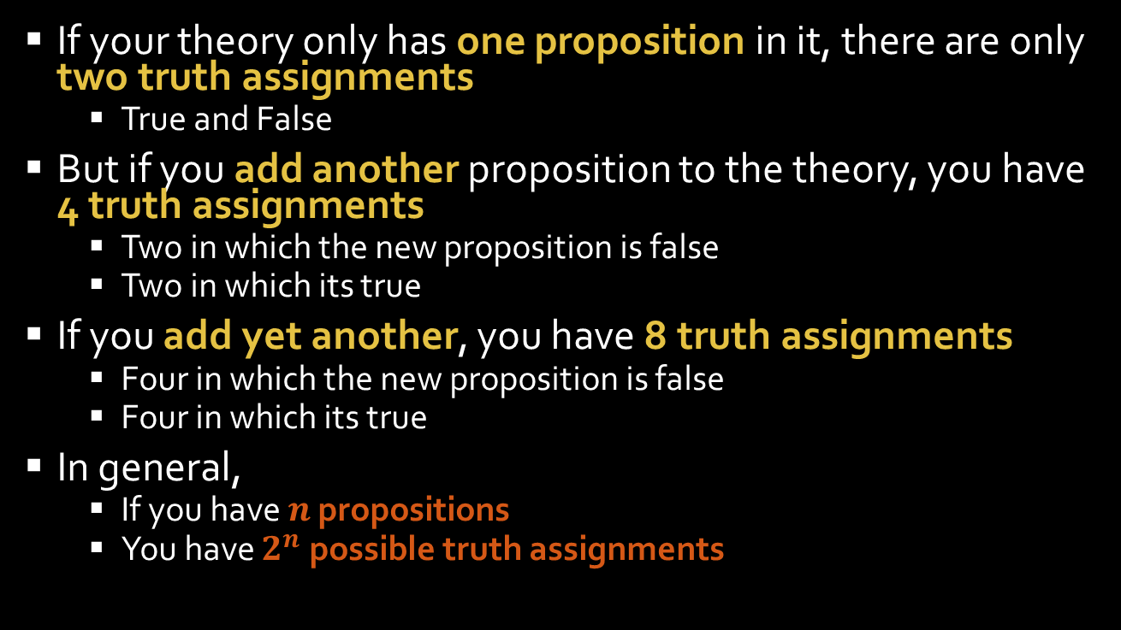
Complexity
If your theory only has one proposition in it, there are only two truth assignments
True and False
But if you add another proposition to the theory, you have 4 truth assignments
Two in which the new proposition is false
Two in which its true
If you add yet another, you have 8 truth assignments
Four in which the new proposition is false
Four in which its true
In general,
If you have $n$ propositions
You have $2^{n}$ possible truth assignments

Slide 11
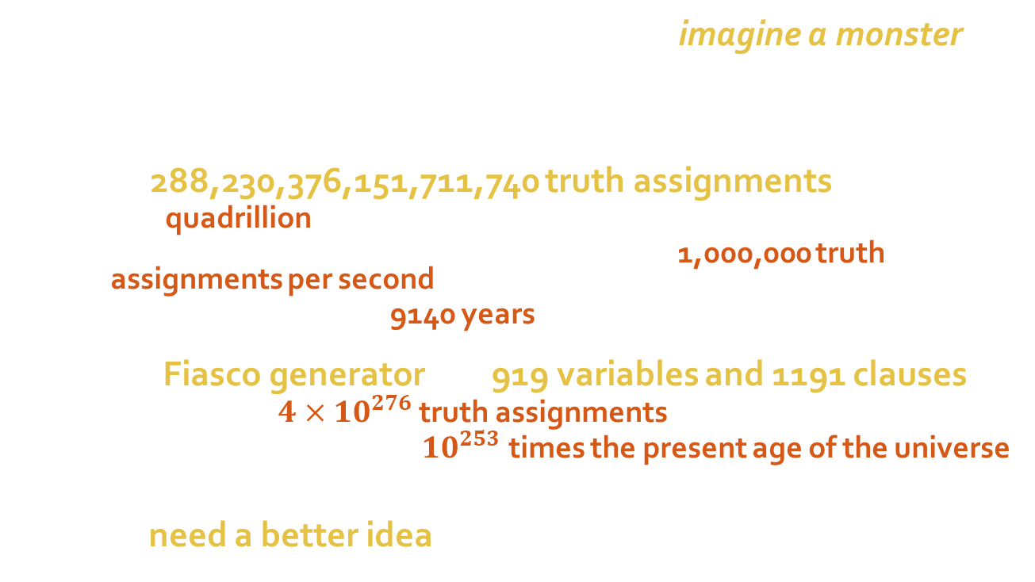
Exponential runtime
In the current assignment, when you type imagine a monster, you get a SAT problem with
58 variables
31 clauses
That’s 288,230,376,151,711,740 truth assignments
288 quadrillion
Computers are fast, so let’s say you can test 1,000,000 truth assignments per second
It would still take you 9140 years to test them all
For my Fiasco generator, it’s 919 variables and 1191 clauses
That’s about $4×{10}^{276}$ truth assignments
So it would take around ${10}^{253}$ times the present age of the universe to try all the possible truth assignments
So we need a better idea than brute force

Slide 12
Stochastic local search

Slide 13
An even worse algorithm
Start with a random truth assignment
Assign each proposition a random truth value
Repeat until solution found
Pick a random proposition
Flip its truth value
If it was false, make it true
If it was true, make it false

Slide 14
Stochastic algorithms
This does a random walk through the possible truth assignments
Starts with one assignment
Tries another that’s similar to it
Then another that’s similar to that one
Etc., until it finds a solution
This is called a stochastic local search algorithm
Search algorithm: it tries a series of guesses
Stochastic: tries a series of things based on random choices
Local: each new guess is “close to” the previous guess

Slide 15
Why is this even worse?
This also blindly tries different truth assignments
But it doesn’t keep track of what it’s already tried
Might try the same one many times
So it can take even longer for find a solution than systematic search
And if you give it a problem with no solution, it will run forever

Slide 16
Conjunctive normal form (clauses)
Most AI systems represent statements in CNF
A big AND
Of a bunch of clauses
Which are a big ORs of
A bunch of literals, which are either
Propositions (A, B, C)
Negated propositions (not A, not B, not C)

Slide 17
A better algorithm
Start with a random truth assignment
Assign each proposition a random truth value
Convert to CNF (i.e. clauses)
Repeat until solution found
Pick a random unsatisfied clause
Unsatisfied means it’s false in the truth assignment, i.e. all of its literal are false in the truth assignment
Pick a random literal in the clause
Flip it

Slide 18
Why is this a better algorithm?
The old algorithm chose propositions randomly
If you flip a proposition from a clause that’s already satisfied, it probably doesn’t help you
It might make things worse
The new algorithm only chooses propositions from unsatisfied clauses
So the flip is guaranteed to at least change that clause to be satisfied
So that’s one bit of guaranteed progress
Unfortunately, it’s still possible for it to make other previously satisfied clauses unsatisfied
So if you’re unlucky, you might make negative progress

Slide 19
The WalkSAT algorithm

Slide 20
A “greedy” algorithm
Start with a random truth assignment
Assign each proposition a random truth value
Repeat until solution found
Pick a random unsatisfied clause
Find the best literal in the clause to flip
Consider each literal in the clause
Compute how many clauses would be satisfied if we flipped it
Choose the one that gives us the most satisfied clauses
Flip it

Slide 21

Hill climbing
Greedy algorithms take greedy steps
Most immediately advantageous
This is referred to as hill climbing
Suppose you’re trying to climb a mountain
Start somewhere
Always step in the steepest direction

Slide 22

Local maxima
Greedy algorithms keep going until they reach some peak
But generally not the highest peak
Might get stuck at the top of a foothill
Because reaching the highest peak would require
Leaving the current peak
Which means going temporarily downhill

Slide 23
Local maxima
This can happen to our SAT solver
Takes greedy steps to satisfy clauses
Hits a local optimum
Not all clauses satisfied
But any single flip will make things worse
It takes the least bad flip
But on the next step, it flips it back
Because that’s the greedy choice
We’ll do a demo shortly

Slide 24
The WalkSAT algorithm
Start with a random truth assignment
Assign each proposition a random truth value
Repeat until solution found
Pick a random unsatisfied clause
Randomly choose
Random step: flip a random literal from the clause
Greedy step: flip the best literal
Most stochastic SAT solvers use variants of WalkSAT

Slide 25
Noise level
You can tune how often it takes random steps
This is called the noise level
Determines how greedy the algorithm is
Noise level 0%
Fully greedy
Really fast when it works
But prone to local maxima
Noise level 100%
Just the original random walk algorithm
Typical noise levels for production systems are around 5% or less

Slide 26
Demo

Slide 27
Improvements

Slide 28
Counting true literals
SAT solvers need to keep checking if clauses are satisfied
A clause is satisfied whenever at least one of its literals is true
So they
Keep tables of the number of true literals in each clause
Update them when they flip a literal
This makes it much more efficient to check if a clause is satisfied
Just check the counts

Slide 29
Adaptive WalkSAT
Imaginarium uses variant of WalkSAT that dynamically adjusts the noise level
When a flip makes progress
i.e. increases satisfied clauses
We’re doing well
Decrease noise level
If flips repeatedly fail to make progress
We’re probably stuck
Increase the noise level

Slide 30
New kinds of constraints
Once you’re keeping counts anyway
Why not let the user specify more flexible constraints based on the number of true literals?
Pseudo-Boolean constraints
Clause is satisfied whenever the number of true literals is in a specified range
Really useful
“a Noun can be X, Y, or Z” => at most one of: not Noun, X, Y, Z is true
“a Noun is X, Y, or Z” => exactly one of: not Noun, X, Y, Z is true
XOR constraints
Clause is satisfied when an odd number of literals is true
Used extensively in code breaking

Slide 31
Pseudo-Boolean constraint demo

Slide 32
DPLL

Slide 33
Non-stochastic algorithms
Imaginarium uses adaptive WalkSAT because
It’s simple
It’s fast enough
It gives random results
It doesn’t use much memory
However, the Davis-Putnam-Logemann-Loveland (DPLL) algorithm is generally the fastest algorithm
And most popular
High performance DPLL implementations with clause learning can solve problems with over a million propositions

Slide 34

Sketch of DPLL (for CS students)
DPLL(clauses)
Pick a proposition $p$
Try setting $p$to true
Substitute true in for $p$ in all the clauses
Check each clause to see if it’s
True because that $p$ is in the clause (as opposed to not $p$)
Remove the clause; we don’t have to think about it anymore
If all the clauses have been deleted, we have a solution
False (all the literals have values, and they’re all false)
We’ve reached a contradiction – backtrack
Give up on setting $p$ to true
Set all the clauses back the way they were move on to setting $p$ false
Has just one literal that doesn’t have a value
Great! Now we know what value to give to that literal
Set the literal to that value and recursively substitute it in
If that didn’t work, try setting $p$ to false
If that didn’t work either, backtrack

Slide 35
Optional
Download the SAT demo from Canvas and play with it
Go to Files > Software
It’s called SATToy
Pick the right zip for your OS
The buttons are
Step: do one flip
Run: keep flipping until solved
Reset: start over
You can select either Test.txt, Grid.txt or Creatures.txt in the File field
Or you can make your own
Put it in the “Problems” folder inside the application folder

